Slide 1


21st May 2015
PRESS CONFERENCE
Radmila Čičković, PhD,
Republika Srpska Institute of Statistics, Director General
Republika Srpska Institute of Statistics

Slide 2
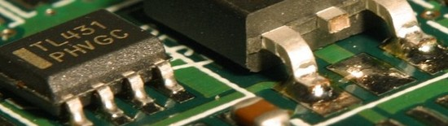
INFORMATION SOCIETY
2014
Personal computer is used by 44.3% of households and 100% of enterprises
Republika Srpska Institute of Statistics

Slide 3
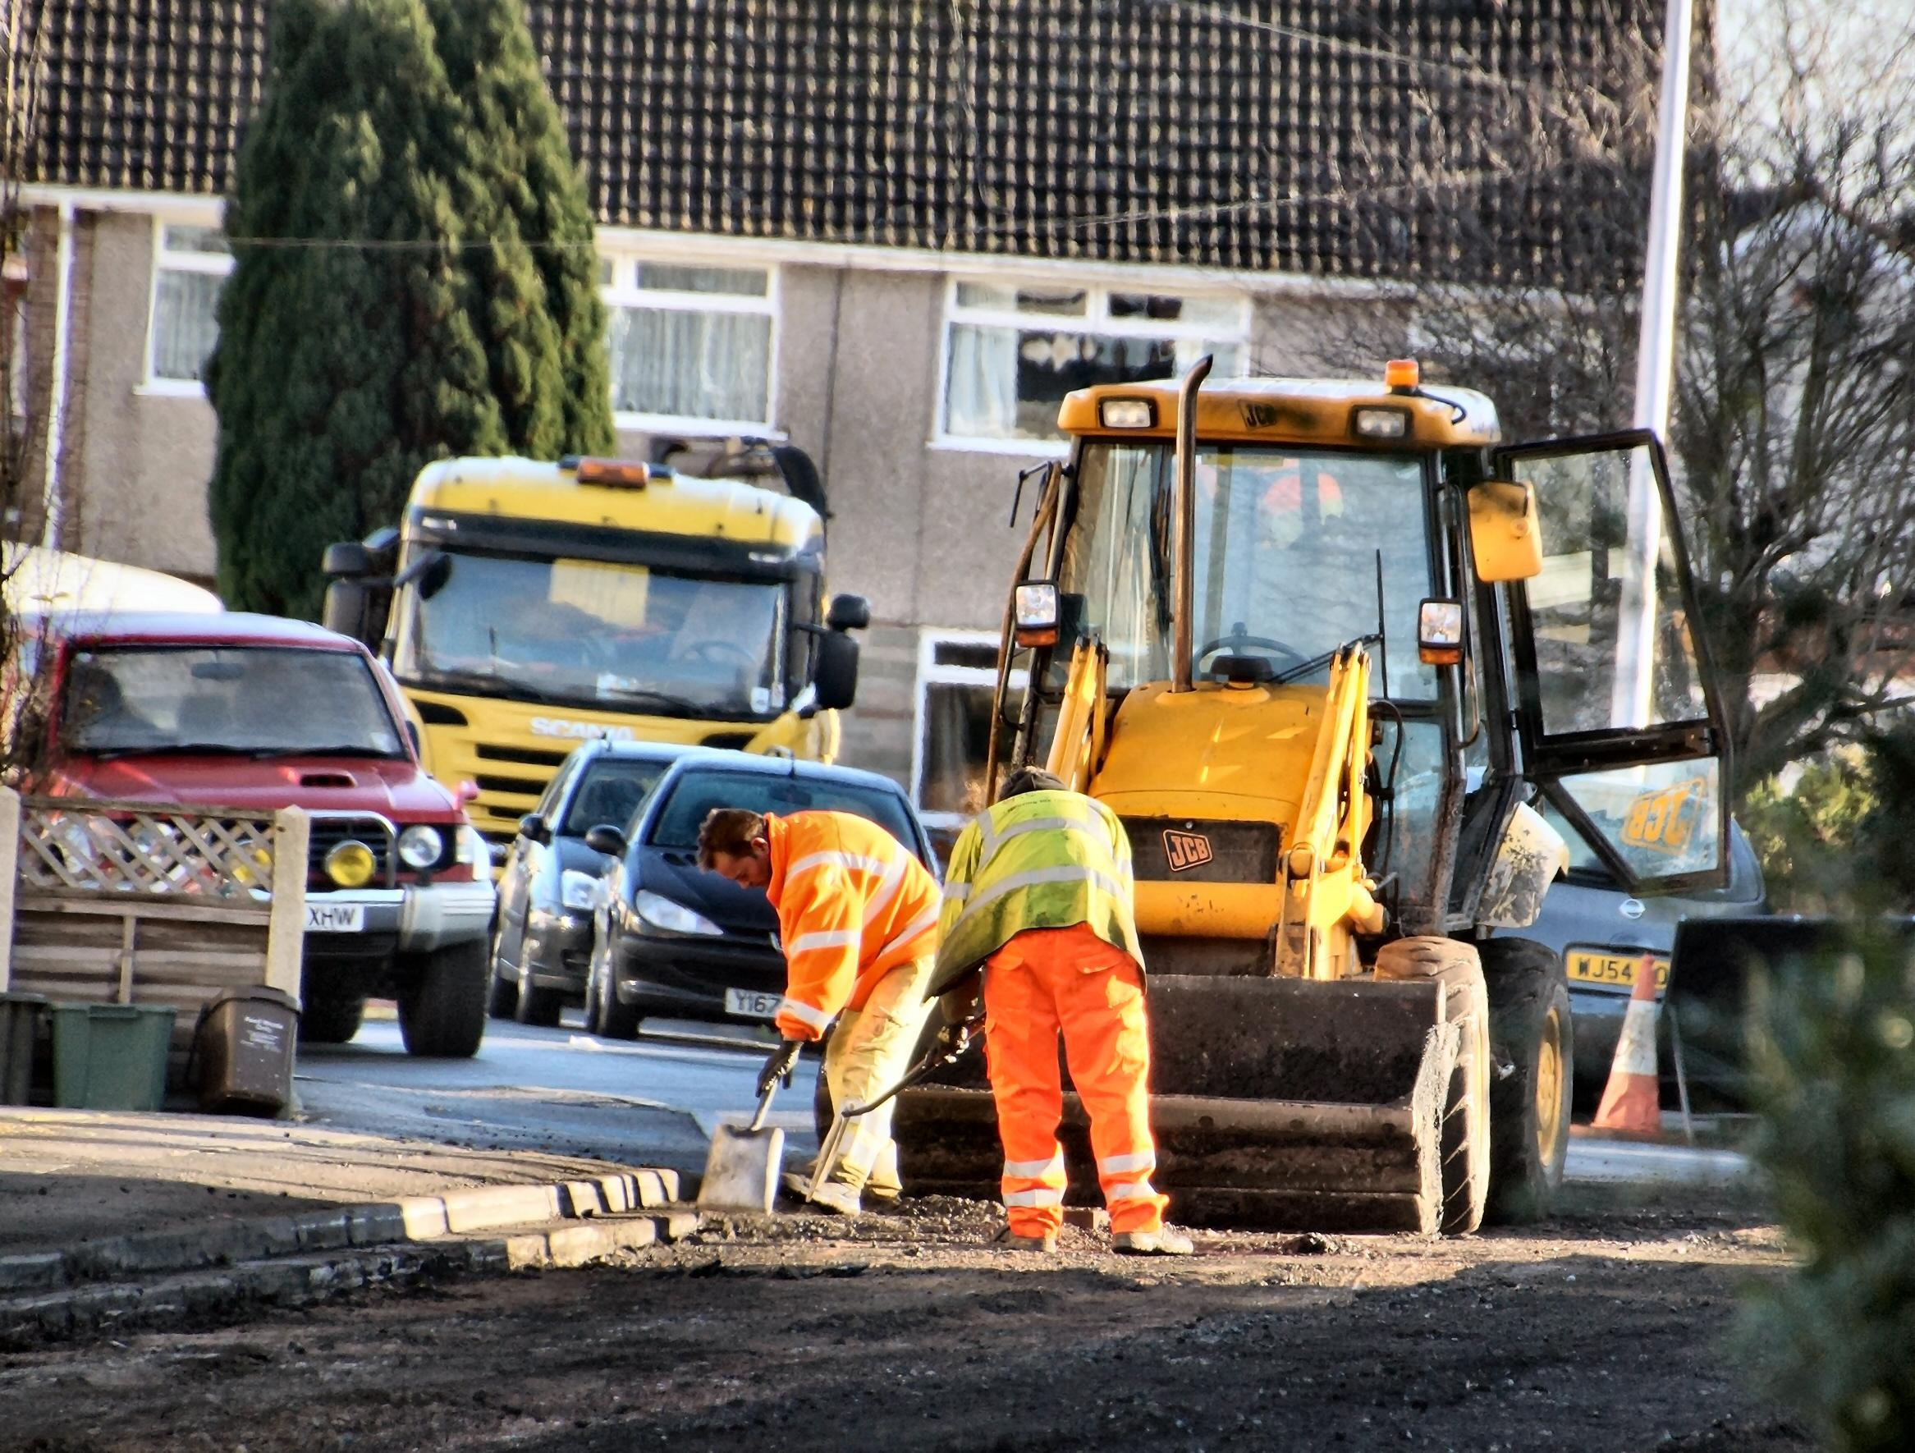
LABOUR STATISTICS
APRIL 2015
Average monthly net wage 835 КМ
Average monthly gross wage 1,346 КМ
Republika Srpska Institute of Statistics

Slide 4
LABOUR STATISTICS
КМ
Republika Srpska Institute of Statistics
Graph 1. Average net wages of employed persons by month

Slide 5

PRICES STATISTICS
APRIL 2015
Monthly inflation -1.1%
Annual inflation (April 2015/April 2014) -0.9%
Republika Srpska Institute of Statistics

Slide 6
PRICES STATISTICS
APRIL 2015
increase in prices
Division Alcoholic beverages and tobacco 0.8%
Division Other goods and services 0.8%
decrease in prices
Division Housing 10.4%
Division Transport 0.3%
Republika Srpska Institute of Statistics

Slide 7
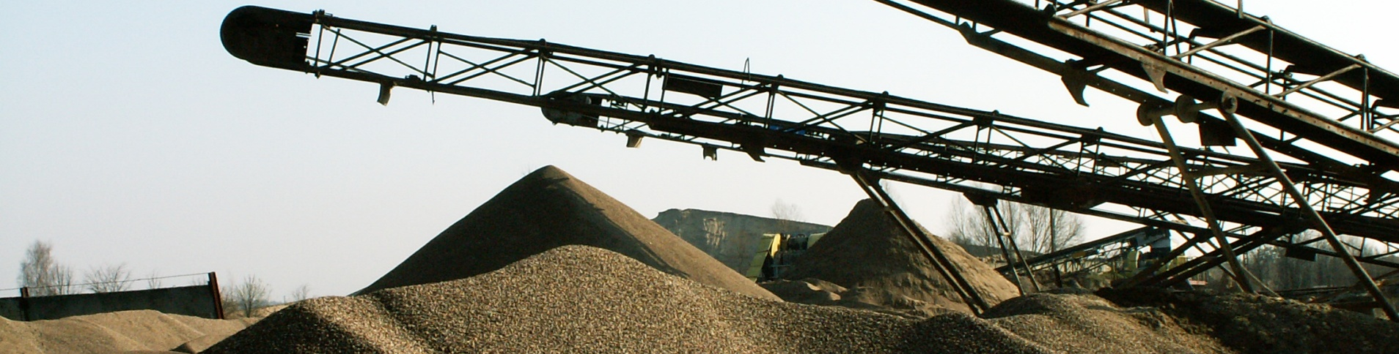
INDUSTRY STATISTICS
INDEX OF INDUSTRIAL PRODUCTION
Working-day adjusted industrial production 2.3% higher
Republika Srpska Institute of Statistics

Slide 8
INDUSTRY STATISTICS
EMPLOYEES IN INDUSTRY
April 2015/April 2014
Number of employees in industry increased by 1.3%
Republika Srpska Institute of Statistics

Slide 9
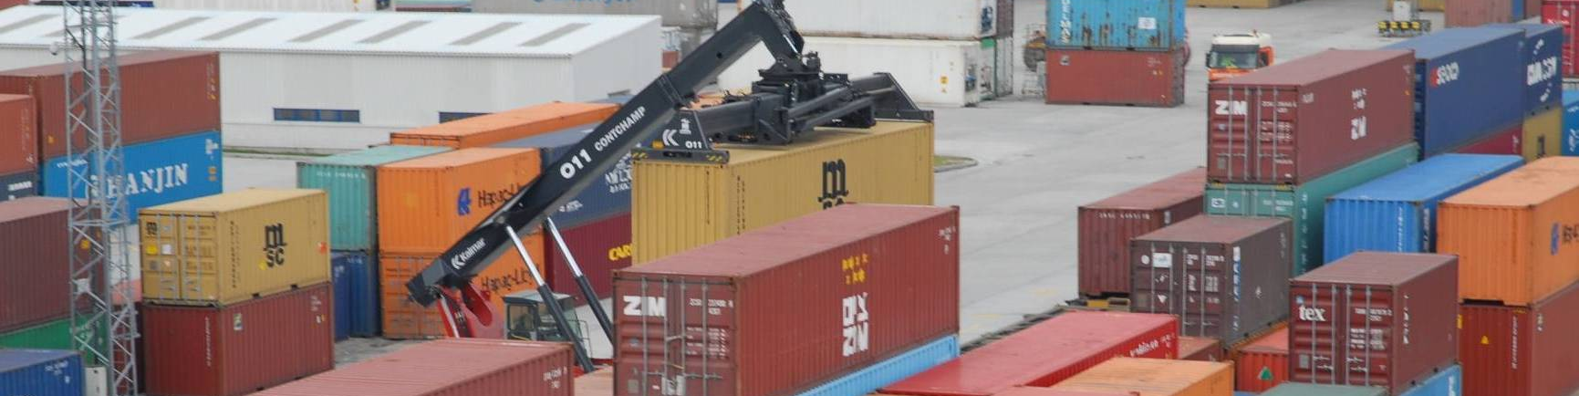
EXTERNAL TRADE STATISTICS
JANUARY-APRIL 2015
Volume of external trade of Republika Srpska 2 billion and 118.2 million КМ
EXPORT 791 million КМ
IMPORT 1 billion and 327 million КМ
Republika Srpska Institute of Statistics
Coverage of import with export 59.6%

Slide 10
EXTERNAL TRADE STATISTICS
thous. КМ
Republika Srpska Institute of Statistics
2014
2015
Graph 2. Export and import by month

Slide 11
EXTERNAL TRADE STATISTICS
JANUARY-APRIL 2015
EXPORT:
Italy 19.0% or 151 million КМ
Serbia 13.5% or 107 million КМ
Germany 10.1% or 80 million КМ
Serbia 17.4% or 231 million КМ
Italy 12.9% or 171 million КМ
Russia 10.9% or 144 million КМ
IMPORT:
Republika Srpska Institute of Statistics

Slide 12
21st May 2015
PRESS CONFERENCE
Republika Srpska Institute of Statistics

